Slide 1


Capstone Project-1
EDA On Hotel Booking Analysis
By
Shivam Pandey
Samardita
Dinesh Nayak
(Cohort:Enlighten)

Slide 2

Index
DATA COLLECTION.
DATA DEFINING.
DATA PREPARATION.
DATA MANUPLATION.
EXPLORATORY DATA ANALYSIS.

Slide 3
Problem Statement:
For this project we will be analyzing Hotel Booking data. This data set contains booking information for a city hotel and as well as resort hotel, and includes information such as when the booking was made, length of stay, the number of adults, children, or babies, and the country visiting the most and many more.
Which Year has the maximum numbers of bookings?
What is the visited no of Adults, Children and babies in each type of hotel?
Which Country Has the maximum numbers of bookings?
Which Hotel gets more Special Request? Show its popularity in terms of speacial request.?
ROOM Price Analysis?
Which Hotels have more cancellation city or resort?
Months with the most numbers of bookings?
Types of market segment?

Slide 4
Work Flow :
So we will divide our work flow into following 3 steps.
Data Collection and Understanding
Data Cleaning and Manipulation
Exploratory Data Analysis(EDA)
EDA will be divided into following 3 analysis.
1) Single Attribute analysis: Single attribute analysis is use to describe the only one characteristics or only one variable.
2) Double Attribute analysis: Double attribute analysis is use for comparing two variables to study their relationships.
3) Multi Attribute anlysis: Multi attribute analysis use for comparing more than two variables.

Slide 5
Data Collection and Understanding:
After collecting data it’s very important to understand your data. So we had hotel Booking analysis data. Which had 119390 rows and 32 columns. So let’s understand this 32 columns.
Data Description:
hotel :Resort Hotel or City Hotel
is_canceled : Value indicating if the booking was canceled (1) or not (0)
lead_time : Number of days that elapsed between the entering date of the booking and the arrival date
arrival_date_year : Year of arrival date
arrival_date_month : Month of arrival date
arrival_date_week_number : Week number of year for arrival date
arrival_date_day_of_month : Day of arrival date
stays_in_weekend_nights : Number of weekend nights
stays_in_week_nights : Number of week nights.
adults : Number of adults
children : Number of children
babies : Number of babies
meal : Type of meal booked.
country : Country of origin

Slide 6
Data Collection and Understanding:
market_segment : Market segment designation.(TA/TO)
distribution_channel : Booking distribution channel.(T/A/TO)
is_repeated_guest : is a repeated guest (1) or not (0)
previous_cancellations : Number of previous bookings that were cancelled by the customer prior to the current booking
previous_bookings_not_canceled : Number of previous bookings not cancelled by the customer prior to the current booking
reserved_room_type : Code of room type reserved.
assigned_room_type : Code for the type of room assigned to the booking.
booking_changes : Number of changes made to the booking from the moment the booking was entered on the PMS until the moment of check-in or cancellation
deposit_type : No Deposit, Non Refund , Refundable.
agent : ID of the travel agency that made the booking
company : ID of the company/entity that made the booking .
days_in_waiting_list : Number of days the booking was in the waiting list before it was confirmed to the customer
customer_type : type of customer. Contract,Group,transient,Transient party.
adr : Average Daily Rate as defined by dividing the sum of all lodging transactions by the total number of staying nights required_car_parking_spaces : Number of car parking spaces required by the customer
total_of_special_requests : Number of special requests made by the customer (e.g. twin bed or high floor)
reservation_status : Reservation last status.

Slide 7
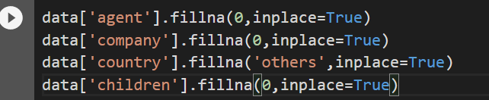
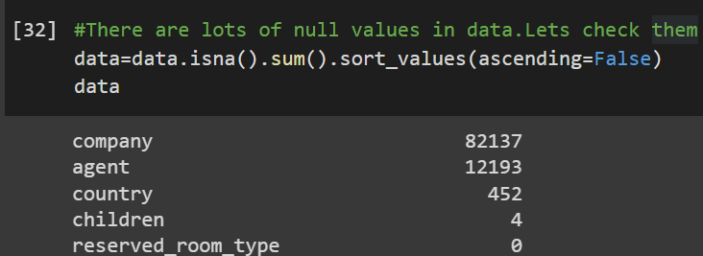
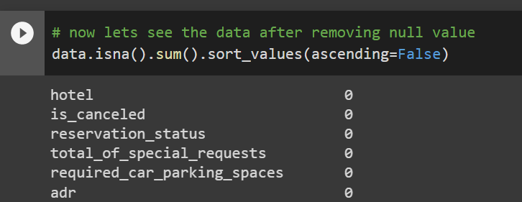
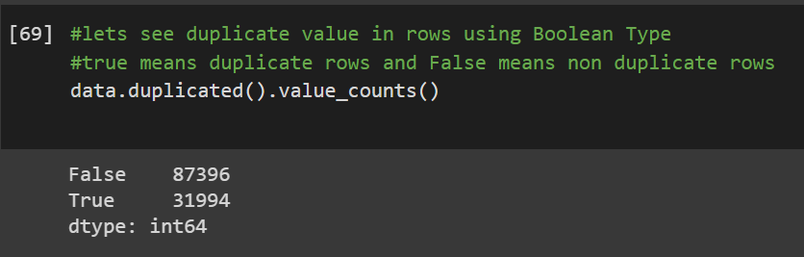
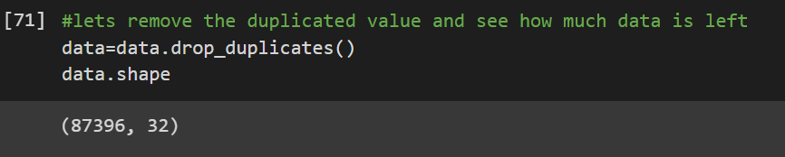
Data Wiping and Trickerie/Manipulation
There were 4 columns company, agent, country and children with missing values.
Handling Duplicates: Lets check duplicate value and drop it from the data

Slide 8
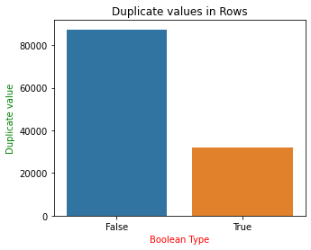
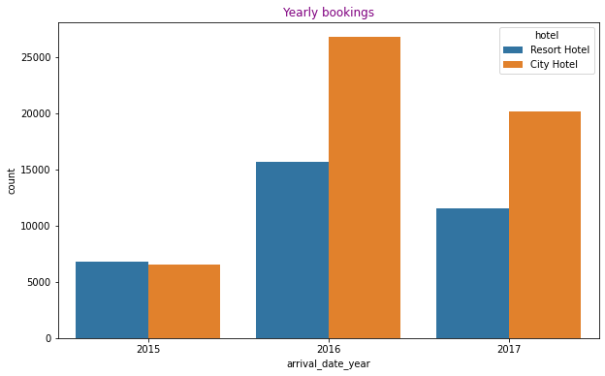
Exploratory Data Analysis(EDA)
Conclusion:
From the graph we can see that the amount of False value are much greater than the True value.
The False value is apprx.36.60% is greater than the True value.
Conclusion
Year 2016 had the highest bookings
In Year 2015 the number of bookings of city and resort Hotels were nearly same.
In year 2016 and 2017 the number of bookings of city hotels were much greater than resort hotels.

Slide 9
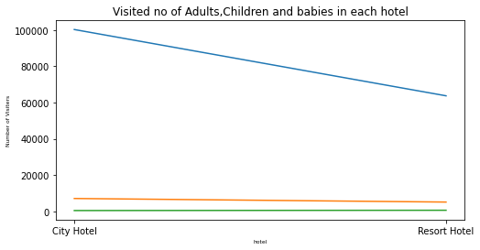
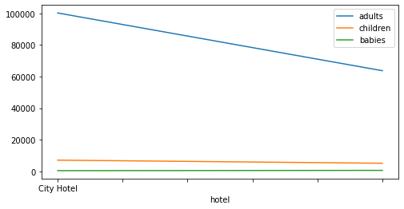
Exploratory Data Analysis(EDA)
Conclusion:
Highest no of visitors are Adults.
Second highest no of visitors are Children.
Least no of visitors are Babies.
Numbers of adults visitors are higher in city hotels as compare to resort hotels.

Slide 10
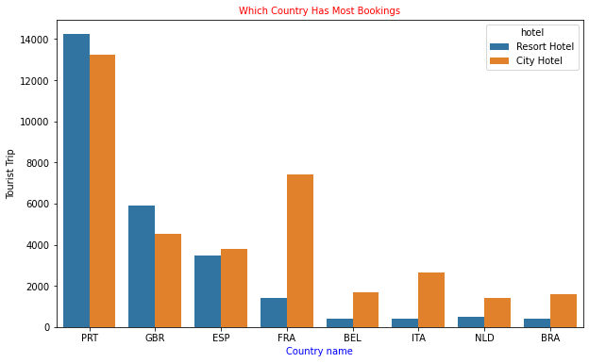
Exploratory Data Analysis(EDA)
CONCLUSION
Portugal has the maximum numbers of bookings.
Brazil has the least numbers of bookings.
Country only Portugal and GBR has more resort hotels bookings as compared to city hotels.
Contries like, Brazil, Itali Belgium,Netherland,has the least number of city resort to hotel resort.
The average sum of bookings of countries (BEL,ITA,NLD,BRA) is less than the bookings of GBR alone.

Slide 11
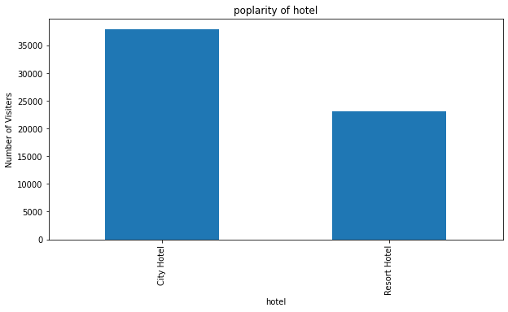
Exploratory Data Analysis(EDA)
CONCLUSION:
City Hotel is likely to reciev more special request than Resort Hotel
We can conclude from the Bar graph that City Hotel is more Popular than Resort Hotel

Slide 12
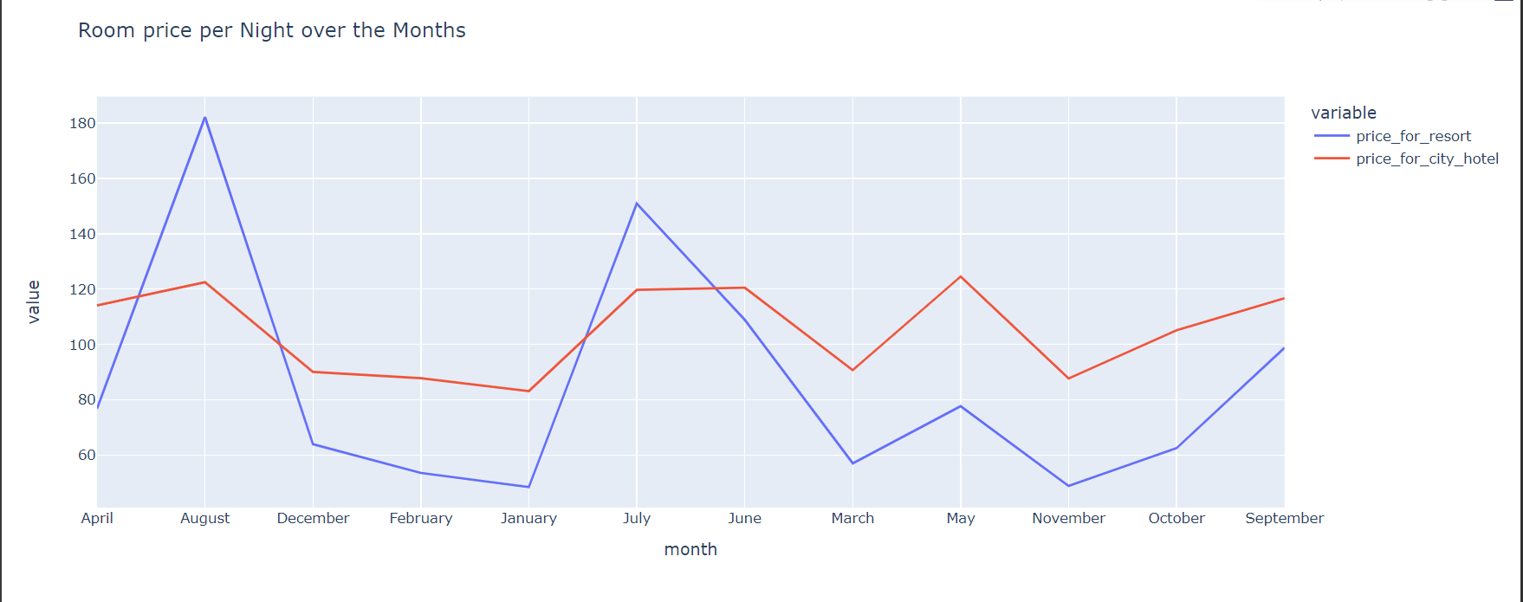
Exploratory Data Analysis(EDA)
Inference:
In August In City Hotel Avg rate per Night was High and On December its Low Same as On City Hotel Its high on Month of May and January its low for Per Night cos.

Slide 13
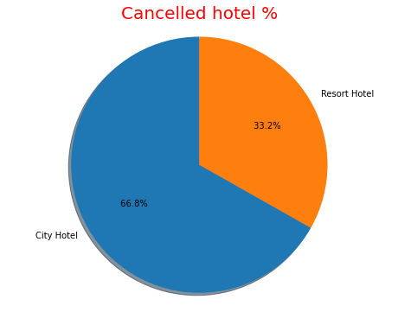
Exploratory Data Analysis(EDA)
Hotels cancellation percentage
COCLUSION:
Resort Hotels:-There are 33.2% cancellation of resort hotels.
City Hotels:-There are 66.80% cancellation of city hotels.
Finally, we can conclude that the cancellation percentage of city hotels is greater than cancellation percentage of resort hotels.
Approx. (cancellation % )city hotels is 2 times greater than resort hotels

Slide 14
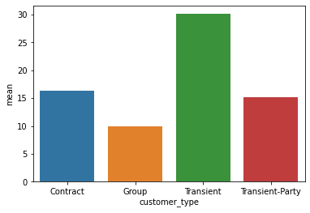
Exploratory Data Analysis(EDA)
Inference:
Transient customer types have higher Cancellation.
The cancellation done by Group is least amoung all.

Slide 15
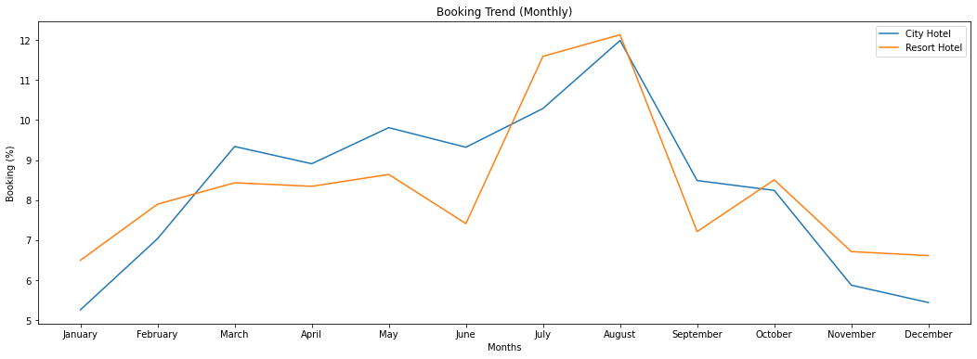
Exploratory Data Analysis(EDA)
Conclusion:
The month August has the busiest month in the year.
In the month of December the least bookings has been monitor.

Slide 16
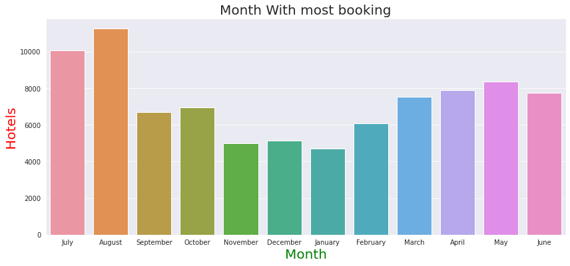
Exploratory Data Analysis(EDA)
Conclusion:
Month August has the maximum number of bookings.
In the month of January people has least visited to the hotels.
In the month of April and June the number of bookings are approx.same.

Slide 17
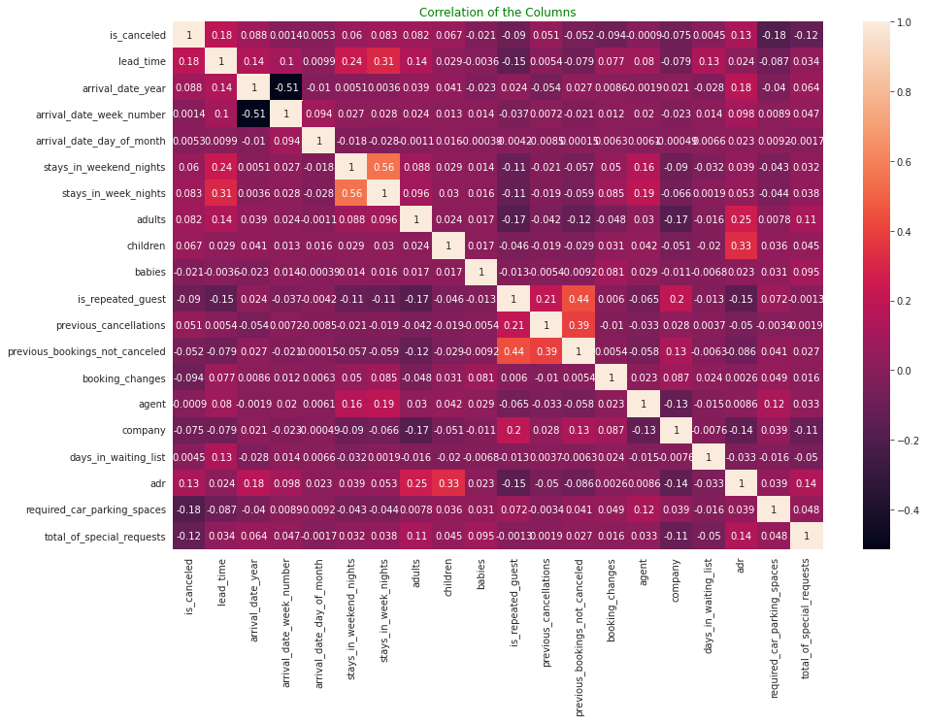
Exploratory Data Analysis(EDA)

Slide 18
Exploratory Data Analysis(EDA)
Conclusion:
Adults,childrens and babies are correlated to each others .This means that the adr id directly proportional to the people. More people more adr and vise versa.
Previous bookings not canceled and is_repeated guest are co related with each others.
same_room and is_cancelled are negatively co related.means if customer is unlikely to cancel his bookings if he is not get same room reserved.
lead_time and total stay are positevely co related. Means more is the stay of the customer more will be the lead time.

Slide 19
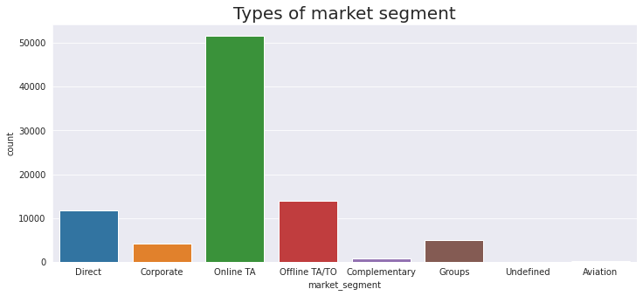
CONCLUSIONS:
Coclusion:
Majority of the distribution channels and market segments involve travel agencies (online or offline).
We can target our marketing area to be on these travel agencies website and work with them since majority of the visitors tend to reach out to them

Slide 20
CONCLUSIONS:
City hotels are the most preferred hotel type by the guests. We can say City hotel is the busiest hotel.
27.5 % bookings were got cancelled out of all the bookings.
Only 3.9 % people were revisited the hotels. Rest 96.1 % were new guests. Thus retention rate is low.
Maximum number of guests were from Portugal, i.e. more than 25000 guests.
Most of the bookings for City hotels and Resort hotel were happened in 2016.

Slide 21
CONCLUSIONS:
Average ADR for city hotel is high as compared to resort hotels.
These City hotels are generating more revenue than the resort hotels.
Booking cancellation rate is high for City hotels which almost 33.3 %.
The time period for City hotel is high as compared to resort hotels. That means city hotels are much busier than Resort hotels.
Resort hotels have the most repeated. guests.
The cancellation done by Group is least amoung all.

